Slide 1




PHILIPPINE CONSTITUTIONS
START!
Click start to begin presentation!
By:
Kyle Tracy Erasmo

Slide 2

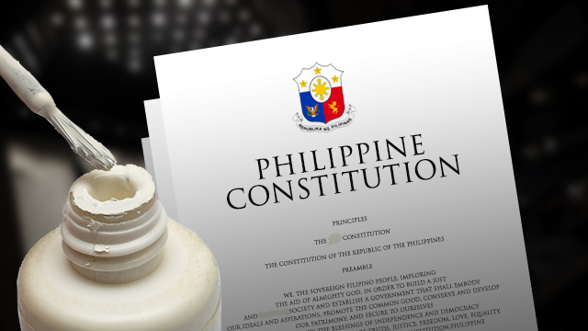
NEXT!
-Justice Miller, US Supreme Court
Meaning of Constitution
In its broad sense, the term constitution refers to the “body of rules and principles in accordance with which the powers of sovereignty are regularly exercised
The Constitution is a written instrument (document) by which the fundamental powers of government are established, limited and defined and by which these powers are distributed among several departments for their safe and useful exercise for their safe and useful exercise for the benefit of the body politic.

Slide 3
Nature and Purposes
WHAT IS CONSTITUTIONAL LAW?
Constitutional Law may be defined as that branch of public law, which treats of constitutions, their nature, formation, amendment, and interpretation. The principles growing out of the interpretation and application made by the courts.
1. Serves as the supreme or fundamental law.
• It is the Character creating the government.
• It is binding to all individual citizens and all organs of the government.
• It is the law to which all other laws must conform.
• It is the test of the legality of all governmental actions.
2. Establishes the basic framework and underlying principles of government.
• Prescribes the permanent framework of the system of government and assigns to the different departments or branches, their respective powers and duties.
• To establish certain basic principles on which the government is founded.
• Designed to preserve and protect the rights of the citizen against the Powers of the State.
3. Designed to protect the basic rights of the people.
• To preserve and protect the rights of individuals against the arbitrary actions of those in authority
• Not to legislate in detail but to set limitations on the government.

Slide 4

Kinds of Constitutions
Table of Contents
Section 1
1. As their origin and history:
2. As to their Form:
Section 2
3.
As to manner of amending them:
Section 3
Section 4
Differences
a. Conventional or Enacted- One of which is enacted by a constituent assembly or granted by a monarch to his subjects like the Constitution of Japan in 1889
b. Cumulative or Evolved- Product of long periods of growth originating in customs, traditions, judicial, decisions, etc.
a. Written- given definite form at a particular time, usually by a specially constituted authority called “constitutional convention”
b. Unwritten- product of political evolution
a. Rigid or Inelastic- one regarded as a document of special sanctity which cannot be amended or altered.
b.Flexible or Elastic- which possesses no higher legal authority
The Philippine Constitution may be classified as conventional or enacted, written and rigid or inelastic. It was crafted by an appointive body called “Constitutional Commission''

Slide 5


Table of Contents
Section 1
Section 2
Section 3
Section 4
OVERVIEW
1899 Constitution of The Philippines
1935 Constitution of The Philippines
1973 Constitution of The Philippines
1987 Constitution of the Philippines

Slide 6
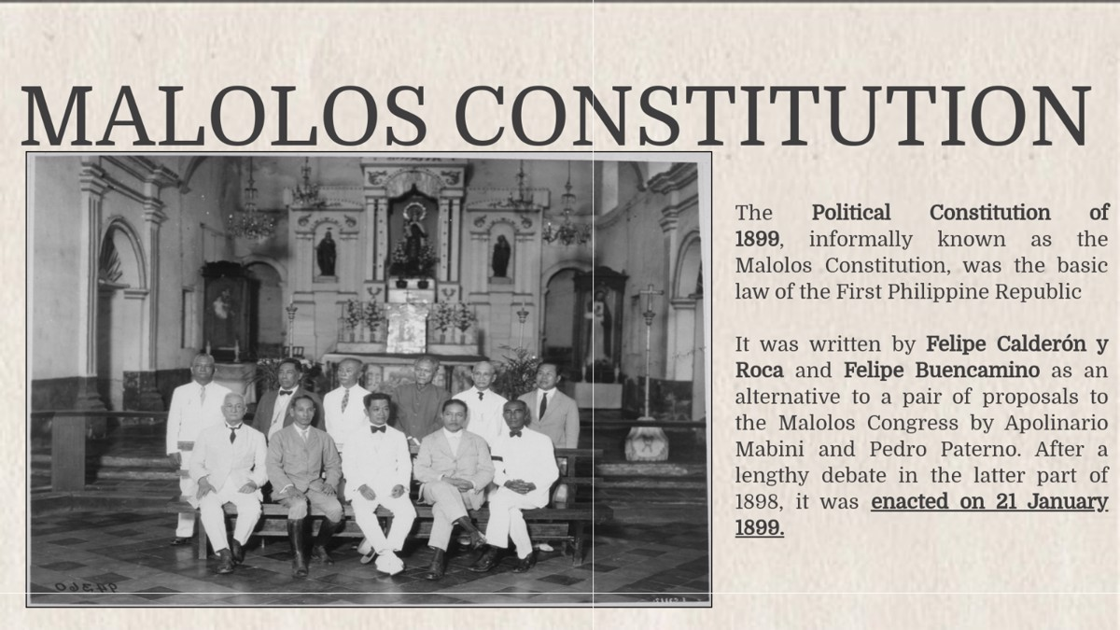
Table of Contents
Section 1
Section 2
01.
Section 3
Section 4
Section 1
Differences
START!
1899 Constitution of the Philippines

Slide 7

Table of Contents
1899 Constitution of the Philippines
Section 1
Section 2
Section 3
Section 4
Differences
The Constitution of 1899 is the Republic of the Philippines' constitution also known as The 1899 Malolos Constitution is the very first constitution of the Philippines.
The Malolos Constitution’s preamble is “We, the Representatives of the Filipino People, legally convened to establish justice, provide for the common defense, promote the general welfare and ensure the blessings of liberty, imploring the aid of the Sovereign Lawgiver of the Universe in order to obtain these objectives, have voted, decreed and approved the following:(titles)”

Slide 8


1899 Constitution of the Philippines
Table of Contents
Section 1
Section 2
Section 3
Section 4
Differences
It was a nascent revolutionary government in the Philippines. It was formally established with the proclamation of the Malolos Constitution on January 21, 1899, in Malolos, Bulacan, and endured until the capture of President Emilio Aguinaldo by the American forces on March 23, 1901, in Palanan, Isabela, which effectively dissolved the First Republic.
The First Philippine Republic was established after the Philippine Revolution against the Spanish Empire (1896–1897) and the Spanish–American War between Spain and the United States (1898). Following the American victory at the Battle of Manila Bay, Aguinaldo returned to the Philippines, issued the Philippine Declaration of Independence on June 12, 1898, and established a revolutionary Philippine government.

Slide 9

1899 Constitution of the Philippines
Table of Contents
Section 1
Section 2
Section 3
Section 4
Differences
In December 1898, Sovereignty over the Philippines was transferred from Spain to the United States in the 1898 Treaty of Paris, making the United States formally the Philippines colonial power. The Malolos Constitution establishing the First Philippine Republic was proclaimed the following month. The Philippine–American War began in February 1899, which the Philippine Republic lost.
The Malolos Constitution was approved by the Malolos Congress on January 20, 1899, sanctioned by Aguinaldo on January 21, and promulgated on January 22. The republic was proclaimed on January 23.
Sources disagree regarding the specific locations which were temporarily capitals of the Philippine Republic. For example: Duka 2008, lists a progression after Malolos from Cabanatuan, Nueva Ecija to Tarlac to Bayombong, Nueva Vizcaya to Bayambang, Pangasinan. Schultz 2000, says that the capital transferred from Malolos to San Fernando, Pampanga. Calit 2003, asserts that Aguinaldo established his capital at San Isidro, Nueva Ecija after abandoning Malolos.
Differences

Slide 10
1899 Constitution of The Philippines
Table of contents
Section 1
Section 2
Section 3
Section 4
Differences
The three parts of the constitution which are of particular interest are:
Article 4, which lists three distinct powers, the legislative, the executive, and the judicial, specifies that any two or more of these powers shall never be vested in a single individual, and specifies that the legislative power shall never be vested in a single individual.
Title VI, comprising articles 54 and 55, which mandate the election of seven legislators to a Permanent Commission which is to meet when convoked by its presiding officer during periods of legislative adjournment. This commission is mandated, among other things, “To act on pending matters which require proper action.”
Article 99, which read, Notwithstanding the general rule established in paragraph 2 of Article 4, in the meantime that the country is fighting for its independence, the Government is empowered to resolve during the closure of the Congress all questions and difficulties not provided for in the laws, which give rise to unforeseen events, by the issuance of decrees, of which the Permanent Commission shall be duly apprised as well as the Assembly when it meets in accordance with this Constitution.

Slide 11

Table of Contents
Section 1
02.
Section 2
Section 3
Section 4
Section 2
Differences
START!
1935 Constitution of The Philippines

Slide 12
Table of Contents
Section 1
The 1935 Constitution was written, approved and adopted in 1934 by the Commonwealth of the Philippines (1935–1946) and later used by the Third Republic (1946–1972). It was written with an eye to meeting the approval of the United States Government as well, so as to ensure that the U.S. would live up to its promise to grant the Philippines independence and not have a premise to hold onto its possession on the grounds that it was too politically immature and hence unready for full, real independence.
The Commonwealth Constitution was ratified to prepare the country for its independence. This constitution was dominantly influenced by the Americans, but possess the traces of the Malolos Constitution, the German, Spanish, and Mexican Constitution, constitutions of several South American countries, and the unwritten English Constitution.
Section 2
Section 3
Section 4
Differences
The Preamble reads:
"The Filipino people, imploring the aid of Divine Providence, in order to establish a government that shall embody their ideals, conserve and develop the patrimony of the nation, promote the general welfare, and secure to themselves and their posterity the blessings of independence under a regime of justice, liberty, and democracy, do ordain and promulgate this Constitution."

Slide 13
1935 Constitution of The Philippines
Table of Contents
Section 1
The draft of the constitution was approved by the convention on February 8, 1935 and was ratified by President Roosevelt in Washington D.C. on March 25, 1935. Elections were held on September 16, 1935 and Manuel L. Quezon was elected as the first President of the Commonwealth of the Philippines.
The original 1935 Constitution provided for a unicameral National Assembly, and the President was elected to a six-year term without the possibility re-election. It was amended in 1940 to have a bicameral Congress composed of a Senate and House of Representatives, as well the creation of an independent electoral commission and to grant the President a four-year term with a maximum of two consecutive terms in office.
Section 2
Section 3
Section 4
Differences
It originally provided for a unicameral legislature composed of a president and vice president elected for a six-year term without re-election. It was amended in 1940 to provide for a bicameral legislature composed of a Senate and a House of Representatives. The President is to be elected to a four-year term, together with the Vice-President, with one re-election; the right of suffrage for male citizens of the Philippines who are twenty-one years of age or over and are able to read and write were protected; this protection, later on, extended to the right of suffrage for women two years after the adoption of the constitution.

Slide 14
1935 Constitution of The Philippines
Table of Contents
Section 1
Section 2
Section 3
Section 4
Differences
A Constitutional Convention was held in 1971 to rewrite the 1935 Constitution. The convention was stained with manifest bribery and corruption. Possibly the most controversial issue was removing the presidential term limit so that Ferdinand E. Marcos could seek re-election for a third term, which many felt was the true reason for which the convention was called. In any case, the 1935 Constitution was suspended in 1972 with Marcos' proclamation of martial law, the rampant corruption of the constitutional process providing him with one of his major premises for doing so.

Slide 15
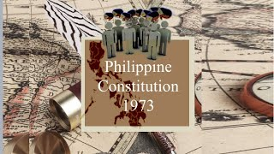
Table of Contents
Section 1
Section 2
Section 3
START!
Section 4
03
Section 3
Differences
1973 Constitution of The Philippines

Slide 16

Table of Contents
Section 1
The Philippines' supreme law is the Constitution of the Philippines (Saliang Batas ng Pilipinas in the Philippines). The Constitution of 1973, composed of a preamble and 17 articles, provides for the transition of the government from the presidential system to the parliamentary system. The constitution vests the legislative power in the National Assembly.
Section 2
Section 3
Section 4
Differences

Slide 17
Table of Contents
Section 1
Section 2
Section 3
Section 4
Differences
In a unicameral National Assembly whose delegates were elected for six-year terms, legislative authority was vested. The President was preferably elected for a six-year term as the symbolic and sole ceremonial head of state selected by the members of the National Assembly and could be re-elected to an infinite number of terms.
The Constitution maintains the independence of the Commission On Elections and creates two independent constitutional bodies [the Civil Service Commission and the Audit Commission] and the National Economic Development Authority [NEDA].
A President is elected from among the members of the National Assembly and serves a six-year term as the symbolic head of state.
A President is elected from among the members of the National Assembly and serves a six-year term as the symbolic head of state.
From among the members of the National Assembly, a prime minister is elected and serves as head of government and commander-in-chief of the Armed Forces of the Philippines.
In the Supreme Court, composed of a Chief Justice and 14 Justices, judicial power is vested.

Slide 18
1973 Constitution of The Philippines
Table of Contents
Section 1
Section 2
Section 3
Section 4
Differences
The Prime Minister, who was also elected from among the sitting Assemblymen, was meant to exercise executive power. The Prime Minister was to be the Head of Government and the Armed Forces' Commander-in-Chief.
The power to define, prescribe and apportion the jurisdiction of the lower courts is exercised by the National Assembly.
All justices of the Supreme Court and judges of the lower courts are appointed by the Prime Minister.
On 24 August 1970, for the purpose of convening a Constitutional Convention, Congress passed RA No. 6132, otherwise known as the Constitutional Convention Act.
While in the process of drafting a new Constitution, President Ferdinand Marcos declared Martial Law on 21 September 1972.
Proclamation No. 1102 was issued by President Marcos, declaring the ratification of the Constitution of the Republic of the Philippines.

Slide 19
1973 Constitution of The Philippines
Table of Contents
Section 1
Section 2
Section 3
Section 4
Differences
The Constitution was amended in 1976, 1980 and 1981; small changes were introduced in 1984.
Up until 1978, the 1973 Constitution allowed Marcos to rule. In fact, it was authoritarian and democratic in practice.
Marcos terminated parity rights between the Americans and Filipinos under this constitution.
The 1973 Constitution allowed 18-year-old citizens to vote, not just men.
Article 3 states that a female citizen retains her citizenship if she marries a resident alien, and that a Filipino citizen is anyone whose mother or father is a Filipino citizen.

Slide 20
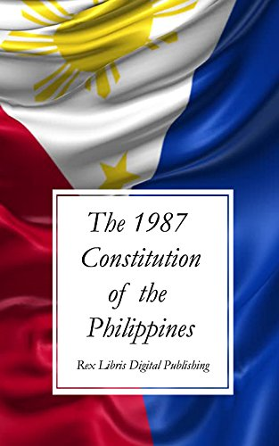
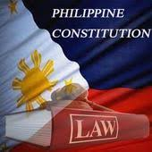
Table of Contents
Section 1
START!
Section 2
Section 3
Section 4
04.
Section 4
Differences
1987 Constitution of the Philippines

Slide 21

The Constitution of 1987 is the Republic of the Philippines' constitution or supreme statute which is still in effect to this very day.
Its final draft was concluded on 12 October 1986 by the Constitutional Commission and approved by a national plebiscite on 2 February 1987.
Three governmental powers, including the executive, legislative and judicial branches, were provided for by the constitution. The president and his designated cabinet members head the executive branch. Together with the other two co-equal branches, the executive has limited power. This is to guarantee that if martial law is to be proclaimed, the government can be "safeguarded" Martial law can also be imposed by the president, but it expires within 60 days and Congress can either dismiss or prolong it.
Also referred to as the "Freedom Constitution", this constitution was meant to guarantee equality and the freedom of the people as a transitional constitution. The Constitution of Independence called for an orderly transition of authority while a new constitution was being drafted by a Constitutional Commission

Slide 22
Three independent Constitutional Commissions, namely the Civil Service Commission, the Commission on Elections and the Commission on Audit, were established by the Constitution. There are distinct roles of these Constitutional Commissions. The Constitution has paved the way for the creation of the Ombudsman's Office, which is responsible for promoting and maintaining the government's ethical and legal behavior.
The Supreme Court's function is to review whether a decree of martial law is just. The legislative power consists of the House of Representatives and the Senate. There are twenty-four senators, and local delegates make up the House. It has provided opportunities for under-represented cultural members to choose their leaders through the structure of party lists. The Supreme Court and the lower courts form the judiciary branch. The Supreme Court is given the authority to hear all cases concerned with the constitutionality of a law, a treaty or decree. It is also responsible for administering the role of the lower courts.

Slide 23
Differences of the Constitutions
Table of Contents
Section 1
Section 2
Section 3
Section 4
Differences
1899
-First constitution of the Philippines, paved the way for the country to be a republic, established the three branches of government, however did not last long because of the american colonization.
1935
- During the commonwealth period, was established as a way for the americans to help us transition to a state of independence,
1973
-During Marcos' regime, created the national assembly, created a parliamentary form of government, a prime minister was elected by the national assembly and a president was elected by the people. The president can declare martial law without the consent of congress.
1987
-Brought back presidential form of government, also called the freedom constitution, clarified the three constitutional commissions; comelec, commission on audit, civil service commission. President cannot declare martial law without consent of congress. The preamble incorporates "God" as a symbol of the edsa revolution.

Slide 24
Thank You!

